Slide 1


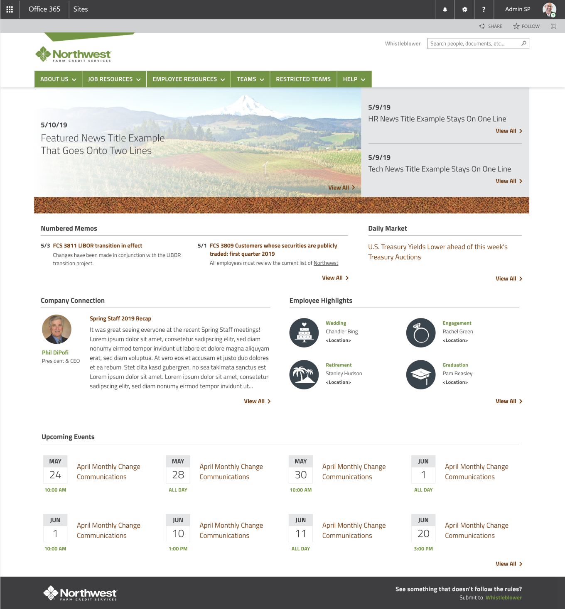
Northwest Farms Credit Services – Corporate Intranet
Who They Are Northwest Farm Credit Service specializes in agricultural lender and crop insurance providers. They have locations spread across Oregon, Washington, Idaho, Montana, and have over 800 employees. They used an on-premise legacy version of SharePoint for years and wanted a major refresh that could promote better collaboration and functionality across all departments.
What Affirma Did
Northwest Farm Credit Service’s old intranet was solely used as a document repository (with bugged links, broken navigation, and unrestricted access. They were looking for a partner to help migrate their intranet onto the latest version of SharePoint online. Once migrated they needed training and support around best practices for o365 features, flow, teams, delve, etc. NWFCS also was looking to increase collaboration and user adoption, Affirma proposed building their new intranet using modern sites, but with custom design to completely re-design their intranet to maximize user adoption and functionality.
Contact Information
Name: Clay E. Morscheck
Title: VP Project Management and Technology
Email: Clay.Morscheck@northwestfcs.com Phone: (509) 340 5489

